Slide 1

ExactSpace Internship Assessment Done By: S. Vamsidhar

Slide 2

Data Preparation
The tactics followed in this work for the treatment of raw data are:
Removal of any instances of categorical data present in the variables and converting all the variables (except “time”) to numeric data type so that further statistical investigations can be followed up as methods such as outlier analysis cannot be possible in the presence of instances of categorical data.
Removal of any instances of null and NaN (Not A Number) as they are small in number and won’t be of any use except adding burden to further statistical investigations.

Slide 3
Analysis Strategy
The statistical tactics followed in this work for the analysis of pre-processed data are:
Analysis of variables (Univariate, Bivariate and Multi-variate) with the help of visualizations (Univariate Distribution Plots, Line Graphs and Box Plots) in order to trace out the presence of instances of observations that stand out from the crowd potentially making them outliers.
But, the main question that arises here is, are outliers the abnormal cases we are trying to find? Yes, to some extent. Outliers not far away from the majority of the values aren't much of a bother as they are most likely to occur in the case of dynamic working environment conditions.

Slide 4
Analysis Strategy
For example, there happens regular cases of high/low temperature/pressure conditions to some extent which are a part and parcel of dynamic factory environment conditions. But, elevated conditions (very high/low temperature/pressure) of the same are considered to be abnormal as they occur due to technical issues which often pose a serious threat to the industry considering the possibility of potential blasts/explosions. In order to trace out those extreme conditions, we have to find out the outliers somewhat far from the majority of the values.
Application of the Z-Score method with varying thresholds ((+/-) 1, 2, and 3 standard deviations away from the mean) to extract the outliers (collective data wise and individual variable wise).

Slide 5
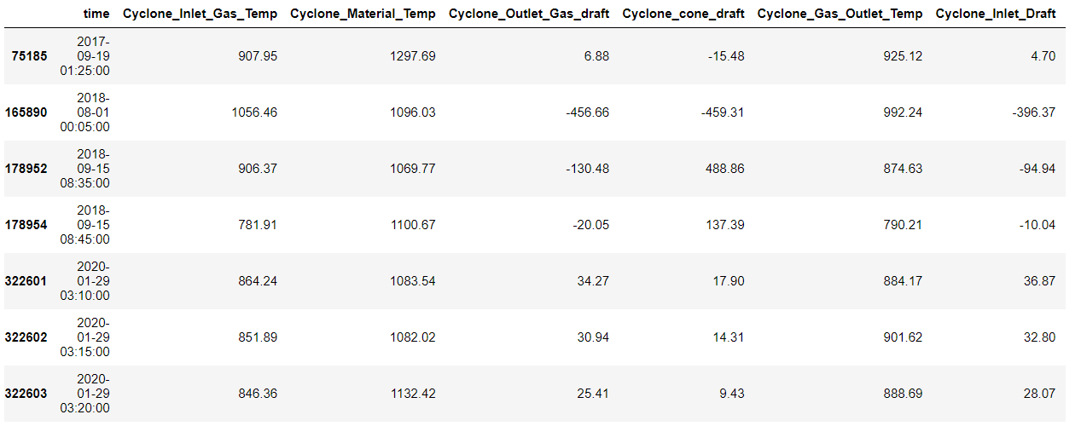
Insights
Once the application statistical techniques are done. One can find the presence of far lying outliers (individual variable and collective data wise) with an increase in the threshold value of the Z-Score method. The more the threshold value, the far the outliers lie. Thus, giving us the required instances of abnormal operational conditions of the cyclone pre-heater.
Here are the potential instances of abnormal operational conditions (7 records).

